Slide 1
Bank Marketing Case Study
By Alexandra Keamy

Slide 2
Objective
This project aims at analyzing data from a direct marketing campaign of a European Banking Institution.
Fixed Term Deposit: investor deposits funds with a financial institution for a period of time and cannot withdraw the funds until the end of the time period
The goals is to be able to predict whether a client will subscribe to a fixed term deposit.
Create an accurate and realistic predictive model can help us figure out who to target for the next marketing campaign.

Slide 3
Data
The data in its raw form contains 22 columns and 41,188 rows.
Data is from a European Banking Institution.
Comprised of client information, previous contact information, and economic factors.
Outcome of interest: y
Binary variables which states whether a client subscribed to a term deposit.

Slide 4
Data Cleaning
Removed all redundant information from the dataset.
Included only relevant columns.
Checked to see if any features had only 1 unique value.
Addressed missingness.

Slide 5
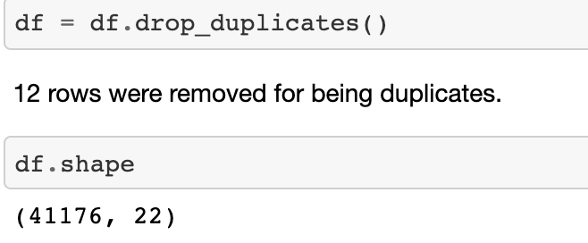
Removing Redundant Information

Slide 6
Included only relevant columns
Removed 'duration' because we will not know the length of the call until the end of the call.
The duration column will skew our model because it is heavily correlated with outcome so we will not use for our prediction model.

Slide 7
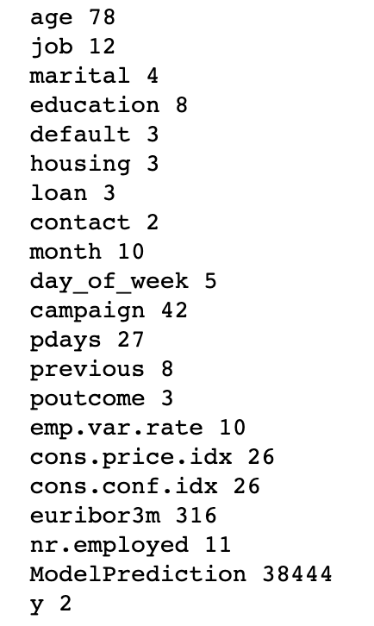
Checked to see if any features had only 1 unique value.
Every feature had at least 2 unique values.

Slide 8
Addressed Missingness
In this dataset, there are no NaN values that exist. However, these values are listed as 'unknown'.
Housing and loan have the same number of unknown. After checking these indexes, those who didn't fill out the loan question also didn’t fill out the housing question. We can remove the unknowns for both housing and loan.
Due to the lack of variation that exists in the default column, it does not seem to be a very informative feature so I removed this column.
Used insight from age and job to fill unknowns in the education column.

Slide 9
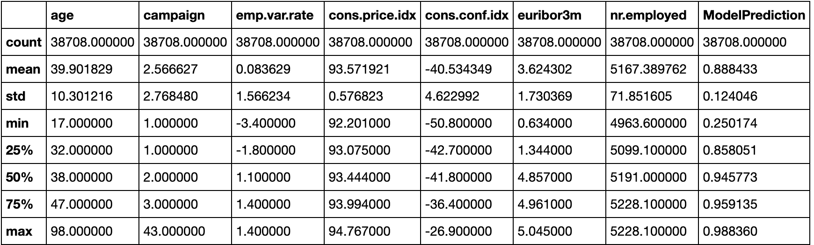
Descriptive Statistics

Slide 10
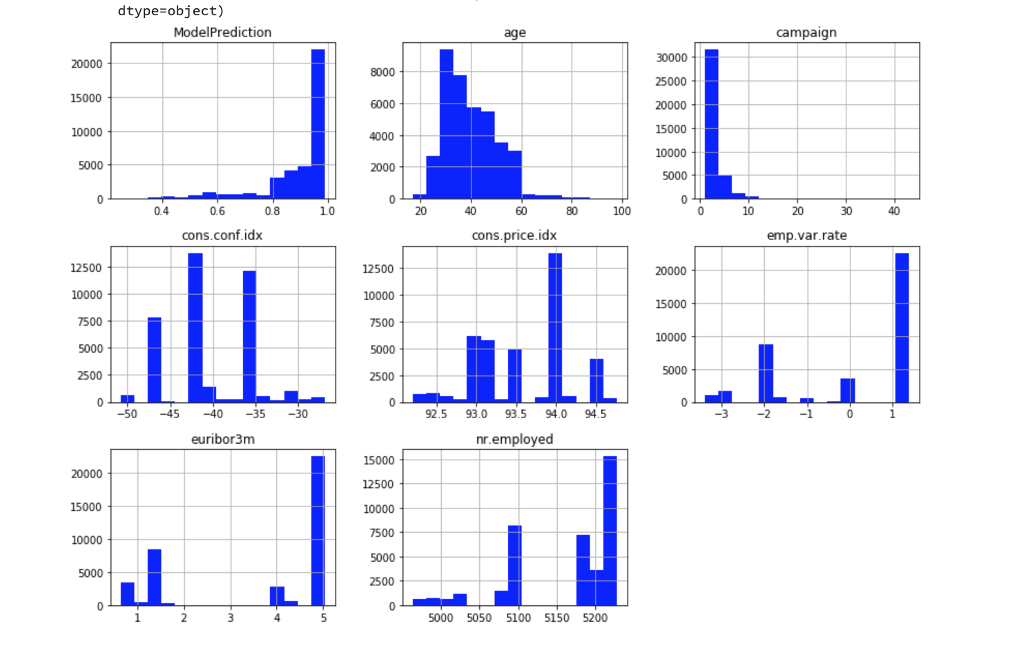

Slide 11
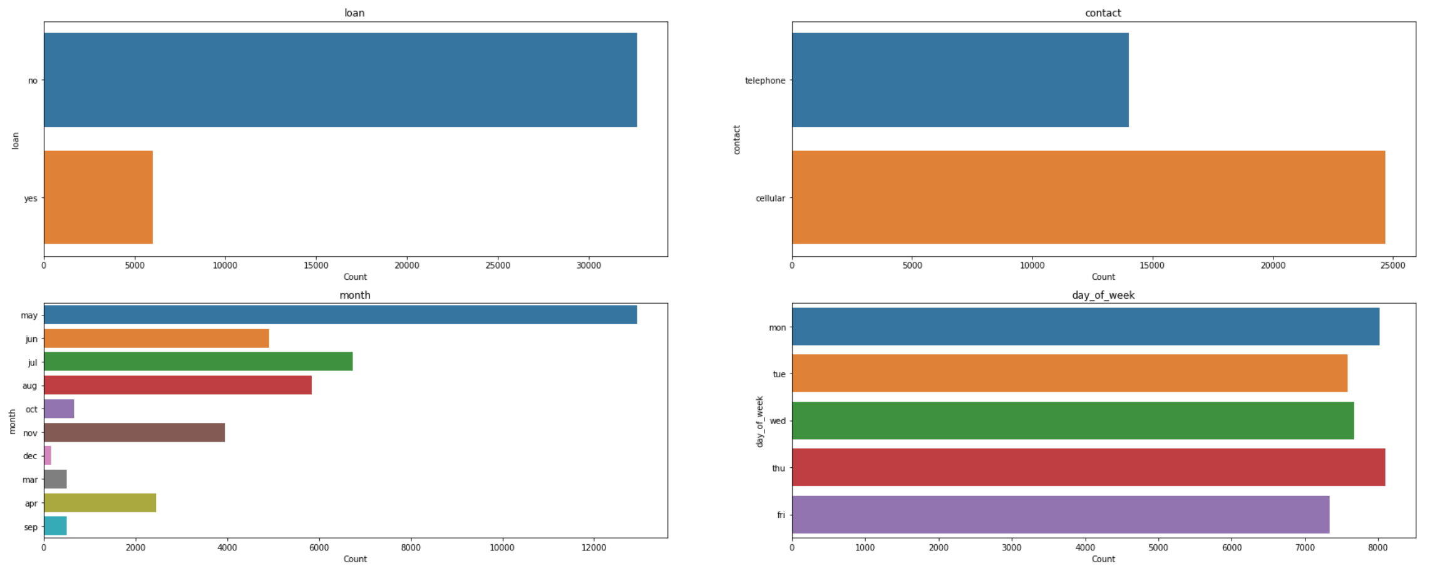
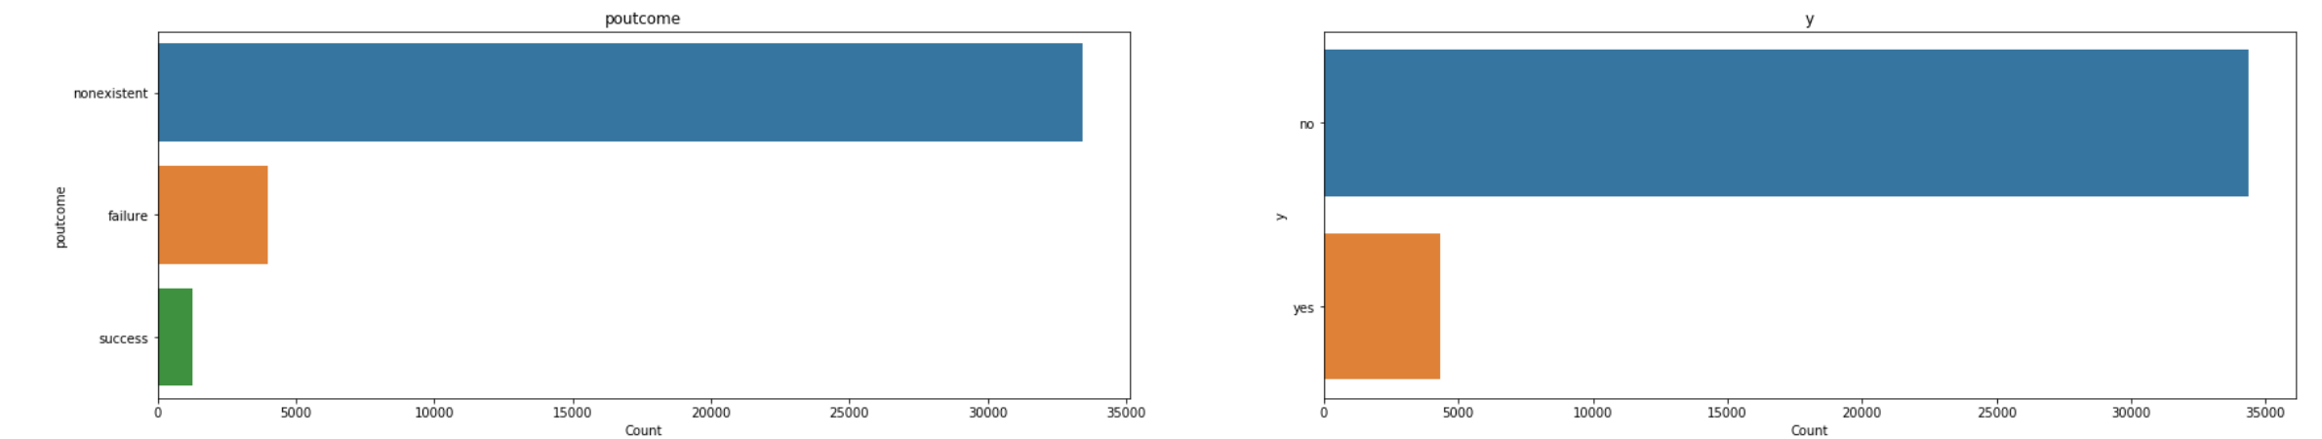

Slide 12
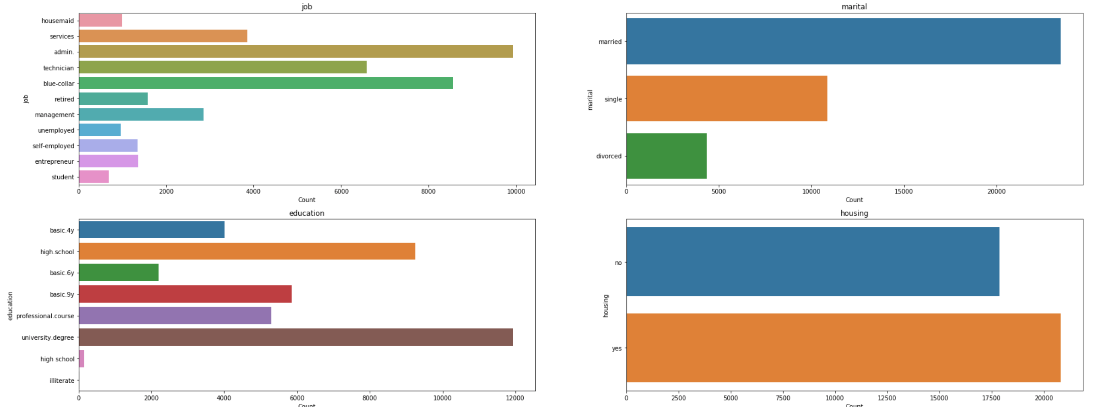

Slide 13
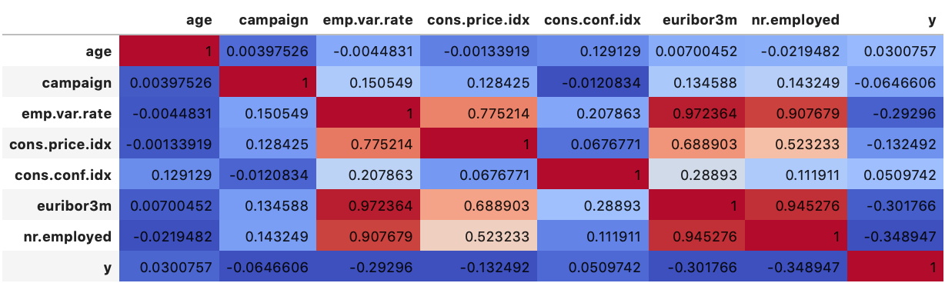
Relationship Between Dependent and Independent Variables
emp.var.rate, cons.price.idx, euribor3m, and nr.employed seem to be the most correlated with y.

Slide 15
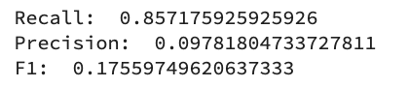
Evaluating ModelPrediction
Chose precision and f1 as metrics for evaluating the models.
ModelPrediction had a very low precision and F1.

Slide 16
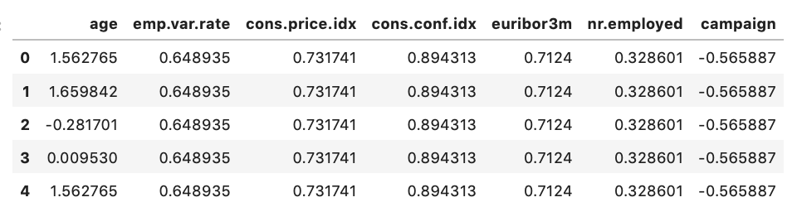
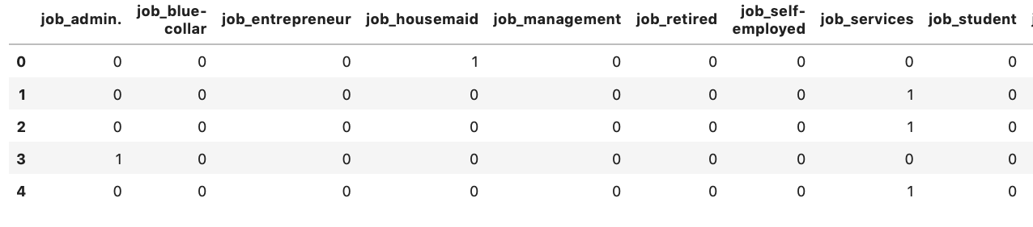
Implementation of Models: Preparing Data
Standardized numeric features
Replaced yes/no with 1/0
Created dummies for categorical variables

Slide 17
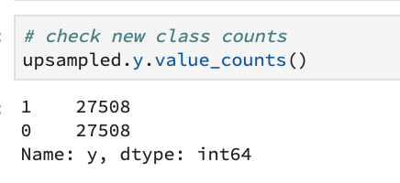
Data Prep Continued
Split Data into Train/Test (80/20)
Upsampled minority class to deal with class imbalance.

Slide 18
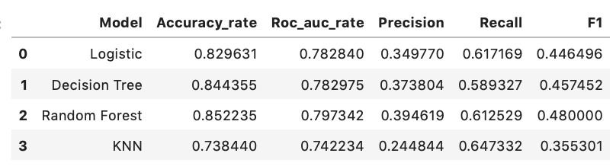
Implementation and Results
Models Chosen: Logistic Regression, Decision Trees, Random Forest, K-Nearest Neighbors, and Gradient Boosting.
Created a pipeling to run a grid search, implement each model, and report model evaluation results.

Slide 19
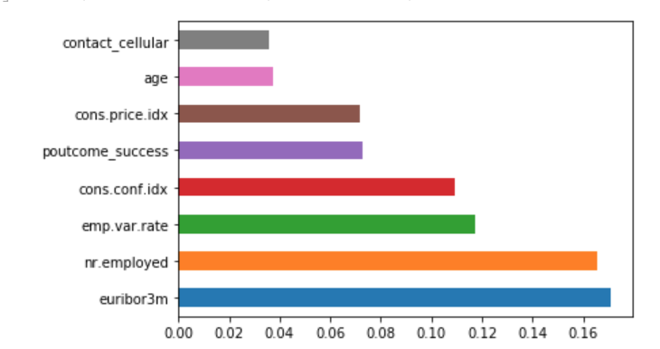
Best Model and Feature Importance
Random Forest performed the best due to its consistency.
Feature Importance for the Random Forest Algorithm:

Slide 20
Conclusion
There is a strong relationship between the economic variables and the probability that a client will subscribe.
A change in employment rate will make people less likely to subscribe (emp.var.rate).
Target older aged people.
Use cellphone as the means of contact.
Prioritize customers part of previous campaigns.

